Slide 1


AUTONOMOUS ENTERPRISE DECISION INTELLIGENCE USING AGENTIC AI
A Coordinated Multi-Agent Framework for Intelligent Enterprise Decision Making
Abhijnya Konanduru Gurumurthy (SUID: 231885826)
Amulya Naga Raj (SUID: 286373513)
Ananya Naga Raj (SUID: 214585923)
Sunil Hanumanthegowda Kote (SUID: 324362001)
Date: April 2026
Course: CIS 600 - Applied Agentic AI Systems
Instructor: Prof. Saman Kumarawadu

Slide 2
From Detection to Decision: Bridging the Intelligence Gap
Problem & Motivation
Research Question
Problem
Enterprise systems continuously track KPIs such as Revenue, Conversion Rate, and Customer Acquisition Cost (CAC) across multiple business dimensions
While anomalies are detected, systems fail to explain the underlying causes or provide actionable insights for decision-making
Key Limitations
Lack of root cause understanding leads to manual, time-consuming, and inconsistent analysis by analysts
Monitoring, diagnosis, and decision-making operate as disconnected stages without coordination or shared state
From Alerts to Decisions
Current Systems → Proposed Agentic Approach
Detect anomalies without context → Detect anomalies with confidence scores and contextual root cause insights
Decisions rely on analyst judgment → Provide ranked, explainable recommendations based on impact, risk, and cost
Motivation
Need for a coordinated, state-aware framework that integrates detection, diagnosis, and decision-making
Enable a transition from reactive alerting systems to structured, consistent, and interpretable decision intelligence
Can a coordinated multi-agent system transform enterprise monitoring into a structured decision-making process by improving accuracy, consistency, and interpretability from anomaly detection to actionable recommendations?
From Alerts to Decisions
Current Enterprise Systems | Proposed Agentic Approach
Detect anomalies in metrics | Detect anomalies with confidence scores
Provide alerts without context | Identifies the rootcause across the dimensions.
Require manual investigation | Rank actions using impact, risk, and cost
Decisions depend on analyst judgment | Provide structured, explainable recommendations
Enterprise systems are increasingly effective at detecting unusual changes in business metrics, but they still lack an integrated framework that can interpret those changes, identify their underlying causes, evaluate possible responses, and recommend what should be done next in a structured and reliable manner.

Slide 3
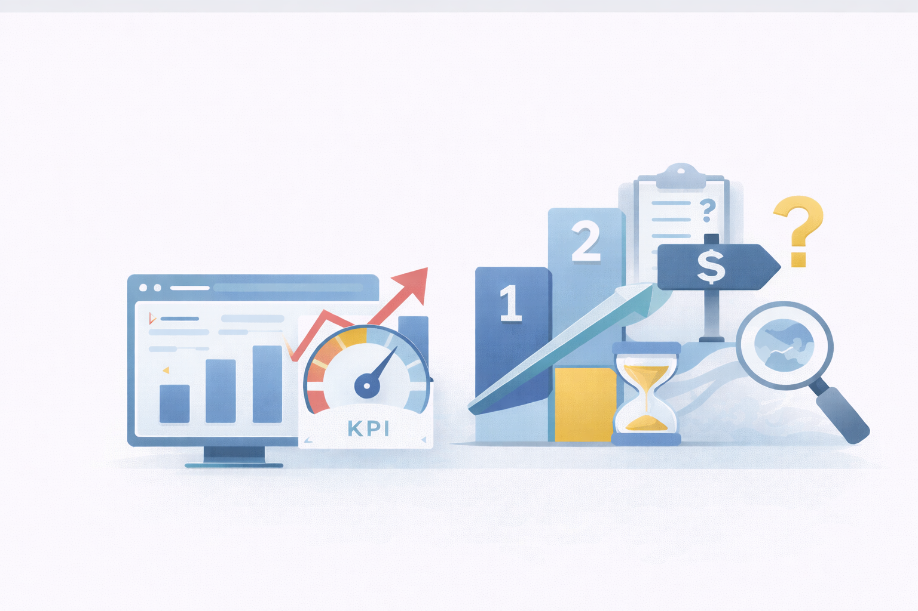
Background and Prior Work
Enterprise Monitoring Systems
Track KPIs such as Revenue, Conversion Rate, and CAC across dimensions like region, product tier, and customer segment
Function primarily as reporting and alerting tools, requiring manual analysis after anomaly detection
Anomaly Detection
Uses statistical techniques such as Rolling Mean, Rolling Standard Deviation, and EWMA to detect deviations from baseline
Effective in identifying anomalies but does not provide insights into contributing factors or causes
Root Cause Analysis (RCA)
Uses contribution-based attribution to measure each dimension’s share of deviation
Produces ranked outputs (Top-1 / Top-3), but lacks integration with downstream decision-making
Limitations in Existing Approaches
Detection, diagnosis, and decision-making exist as independent and disconnected stages
No shared state or coordination, leading to inconsistent interpretation and delayed response
Research Gap
Lack of an end-to-end coordinated framework integrating detection, RCA, and decision-making
Limited systems provide structured, explainable decision recommendations beyond anomaly alerts
Our Contribution
Propose a coordinated multi-agent system integrating detection, diagnosis, and decision-making within a unified pipeline
Introduce Central Controller and Shared Memory with utility-based decision ranking and controlled LLM-based explanation
Transforms isolated analytical steps into a unified and coordinated decision intelligence framework

Slide 4
Dataset and Preprocessing
Dataset
Google Analytics 4 (GA4) Obfuscated E-commerce Public Dataset, sourced from Google BigQuery, consisting of large-scale event-level enterprise web analytics data
Contains user sessions, traffic sources, event logs, and purchase activity, enabling derivation of structured business metrics
Key Metrics
Core KPIs are daily revenue, purchases, and sessions , with derived conversion_rate, aov, a proxy cac, and churn, and optional revenue splits by region/channel/segment for attribution, while the agent pipeline usually monitors one metric at a time
Additional behavioral signals derived from event data, including churn-related indicators and user interaction patterns
Preprocessing
Event-level data is transformed into structured time-series format by aggregating events over defined time intervals
Metrics are aligned and standardized across dimensions such as region, product tier, and customer segment for consistent analysis
Feature Engineering
Computation of Rolling Mean and Rolling Standard Deviation to establish dynamic baseline behavior for each metric
Application of Exponentially Weighted Moving Average (EWMA) to smooth short-term fluctuations and capture recent trends
Preparation for Analysis
Baseline behavior is established across all metrics to support reliable deviation detection
Structured and consistent inputs are generated for downstream anomaly detection and root cause analysis modules
Transforms raw event data into structured time-series inputs for analysis

Slide 5
Model Architecture and Approach
System Architecture
A 5-agent coordinated system consisting of Monitoring, Anomaly Detection, Root Cause Analysis, Decision, and Explanation agents
All agents are governed by a rule-based Central Controller and communicate through a shared state.
Core Framework
The system follows a structured pipeline:
Perception → Reasoning → Action → Feedback
Each stage depends on validated outputs from the previous stage, ensuring controlled and sequential execution
Central Controller & Shared Memory
Central Controller manages execution flow, enforces confidence thresholds, and triggers re-evaluation when outputs are inconsistent
Shared Memory maintains system state, including metrics, anomaly scores, confidence levels, root causes, and decision outputs
Decision Logic
Anomaly Detection: Rolling Mean, Rolling Standard Deviation, and EWMA for identifying deviations
Root Cause & Decision: Contribution-based attribution for diagnosis and utility-based ranking (impact, risk, cost) for actions
Controlled Intelligence
LLM is used only for explanation generation, based strictly on computed statistical outputs
Ensures explainability while preventing uncontrolled reasoning or deviation from quantitative results
Transforms isolated analytical steps into a coordinated, controlled decision-making system.

Slide 6
Experimental Setup
Dataset Execution
Time-series metrics have been constructed from the GA4 dataset for analysis
Sequential replay setup is designed to simulate real-time enterprise data flow
Test Scenarios
Controlled anomaly scenarios such as revenue drops and traffic spikes are defined for evaluation
Natural variations from the dataset are identified to reflect realistic system behavior
Baseline Systems
Baseline comparison framework is defined, including:
Static threshold-based alert system
Single anomaly detection model
Manual analysis workflow
Comparative evaluation against these baselines is planned
Evaluation Metrics
Evaluation framework is defined to assess system performance
Metrics include:
Detection: Precision, Recall, F1-score, Detection latency
Root Cause: Top-1 and Top-3 accuracy
Validation Status
Reproducibility strategy is planned using multiple runs and consistency checks
Full evaluation, including decision and explanation metrics, is in progress
Evaluates the system against real and controlled scenarios using measurable metrics

Slide 7
Results, Findings and Error Analysis
Implementation Status
Implemented the anomaly detection module using rolling mean, rolling SD, and EWMA, and validated it on the dataset.
Established the integration flow between anomaly detection and root cause analysis, ensuring that outputs from detection can be used for further analysis.
Preliminary Observations
Rolling statistics and EWMA show stable behavior in identifying deviations from baseline
Structured time-series representation enables consistent input for downstream analysis
System-Level Progress
Multi-agent architecture, Central Controller, and Shared Memory design are defined
Coordination logic for stage-wise execution and confidence-based progression is being developed
Challenges Encountered
Attribution becomes difficult when multiple dimensions contribute with similar magnitude
Sensitivity of anomaly detection depends on rolling window size and EWMA parameters
Current Limitations
Root cause analysis, decision ranking, and explanation modules are not fully implemented
End-to-end evaluation and comparative performance analysis are still in progress
The proposed system is designed to deliver consistent, interpretable, and actionable decision intelligence

Slide 8
Conclusion, Limitations and Future Enhancement
Conclusion
This project presents a coordinated multi-agent framework that transforms enterprise monitoring into a structured decision intelligence pipeline
The system enables a complete flow from anomaly detection to root cause identification and decision recommendation, improving consistency and interpretability
By integrating perception, reasoning, action, and feedback, the system establishes a controlled and explainable decision-making process across enterprise workflows
Key Contributions
Design of a 5-agent architecture integrating Monitoring, Anomaly Detection, Root Cause Analysis, Decision, and Explanation agents
Introduction of a Central Controller and Shared Memory to enable state-aware coordination and controlled execution across stages
Implementation of statistical detection, attribution-based diagnosis, and utility-based decision ranking, combined with constrained LLM-based explanation
Limitations
Focused on structured numerical time-series data from enterprise analytics environments
System behavior depends on statistical parameter settings such as rolling window size and EWMA weighting
Handling cases with multiple contributing dimensions remains challenging due to attribution ambiguity
Future Work
Extend evaluation with comprehensive baseline comparison and system-level validation
Expand to real-time streaming pipelines and multi-domain enterprise data sources
Explore adaptive parameter tuning and confidence-based mechanisms for improved robustness
The project shifts enterprise monitoring from alert generation to structured, explainable decision intelligence

Slide 9
Thank You!

